Slide 1


Eco-systems mapping of Strategic Domains

Slide 2
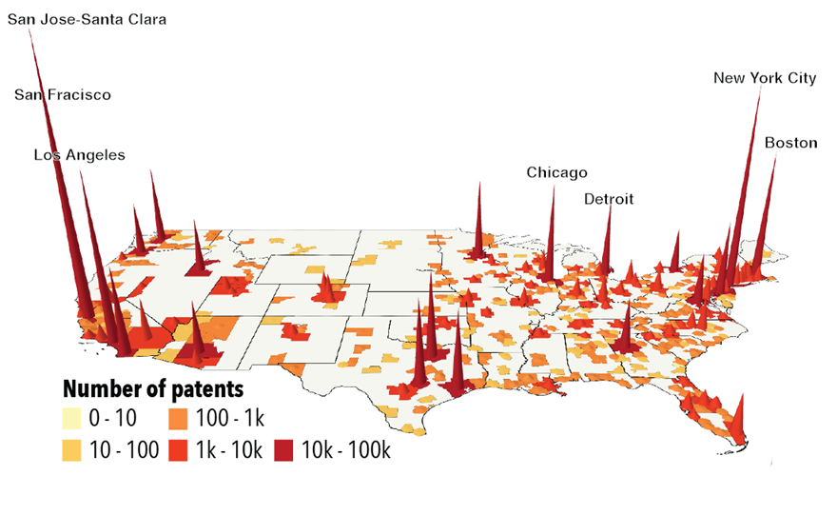
Innovation is highly concentrated
Balland et al. (2020): nature.com/articles/s41562-019-0803-3

Slide 3
High-resolution mapping of regional ecosystems is essential for open innovation efforts and strategy:
Prioritize investment decisions
Set-up new R&D labs and incubators
Initiate strategic collaborations & M&A
Identify technological opportunities
Monitor competitor’s technological change
Bottleneck: increasing complexity of the technological landscape

Slide 4
Applied artificial intelligence +
high-end data visualization tools
Support Continental’s innovation efforts by mapping worldwide eco-systems in 8 strategic domains
Hydrogène

Slide 5
Methodological note

Slide 6
Methodological note
1
Theoretical framework of economic complexity
2
Analysis of large patent datasets
3
Applied Artificial Intelligence (ML/NS)
4
High-end interactive data visualization tools (HTML)

Slide 7
Technological profile of strategic domains

Slide 8
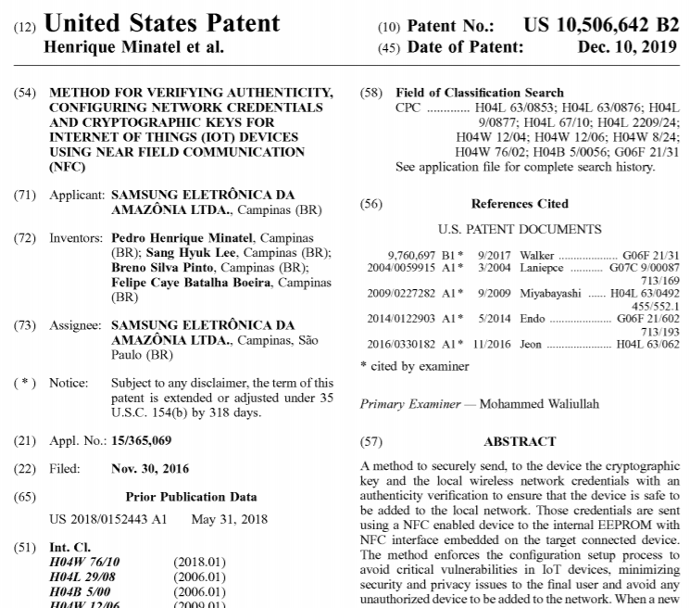

Slide 9
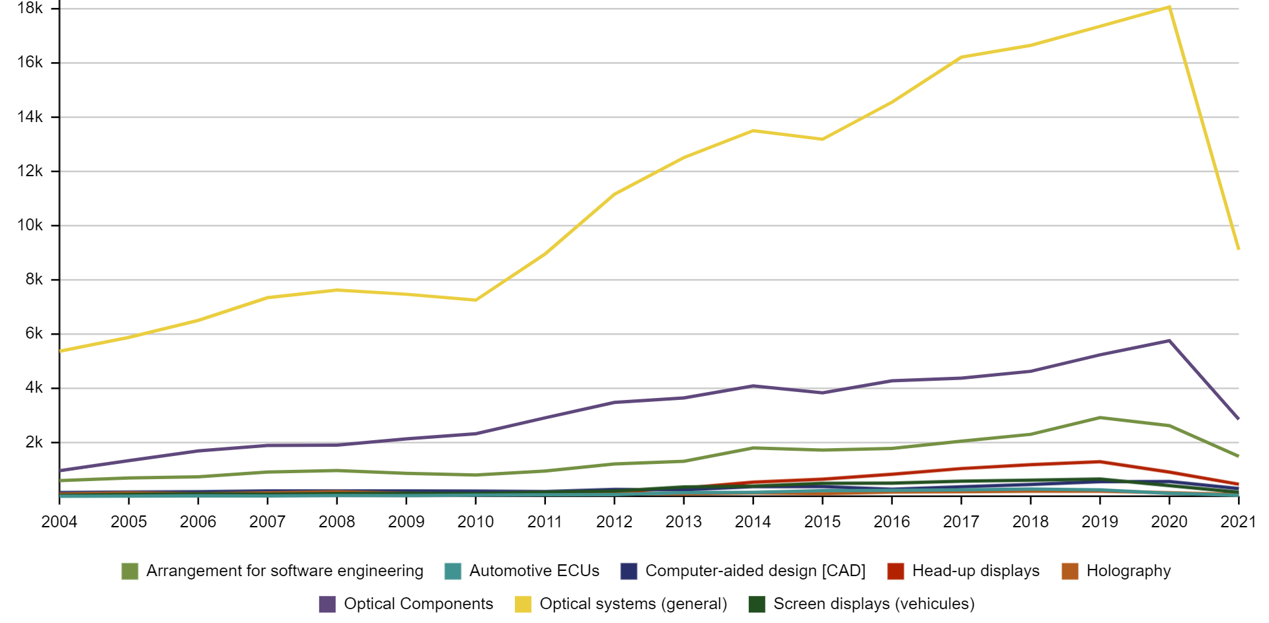
Patent velocity

Slide 10
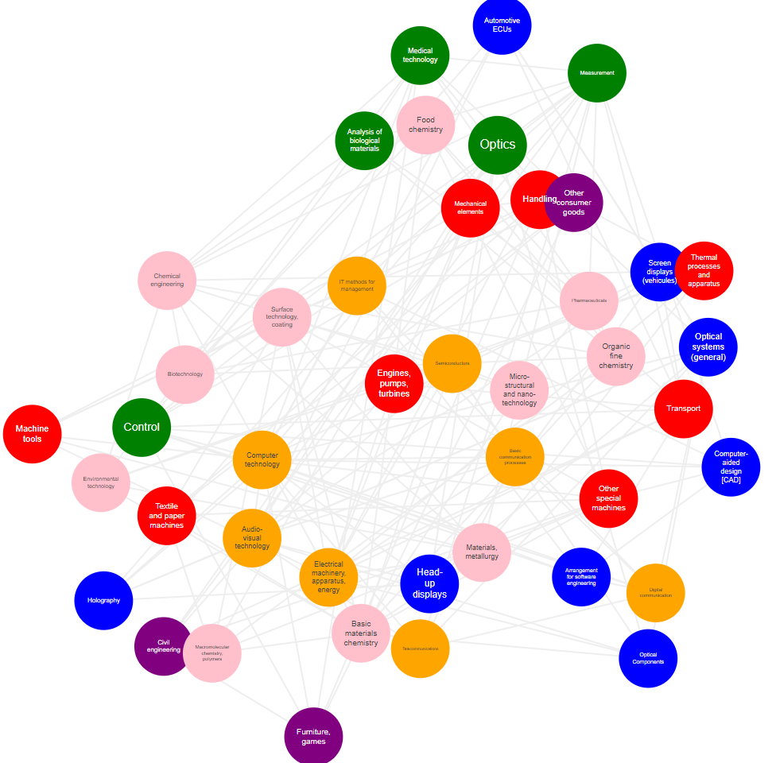
Technology space
- Represents technological links between strategic domains
- Based on normalized cooccurrences on same patents
- Allows the recommendation system to evaluate technological opportunities in regions

Slide 11
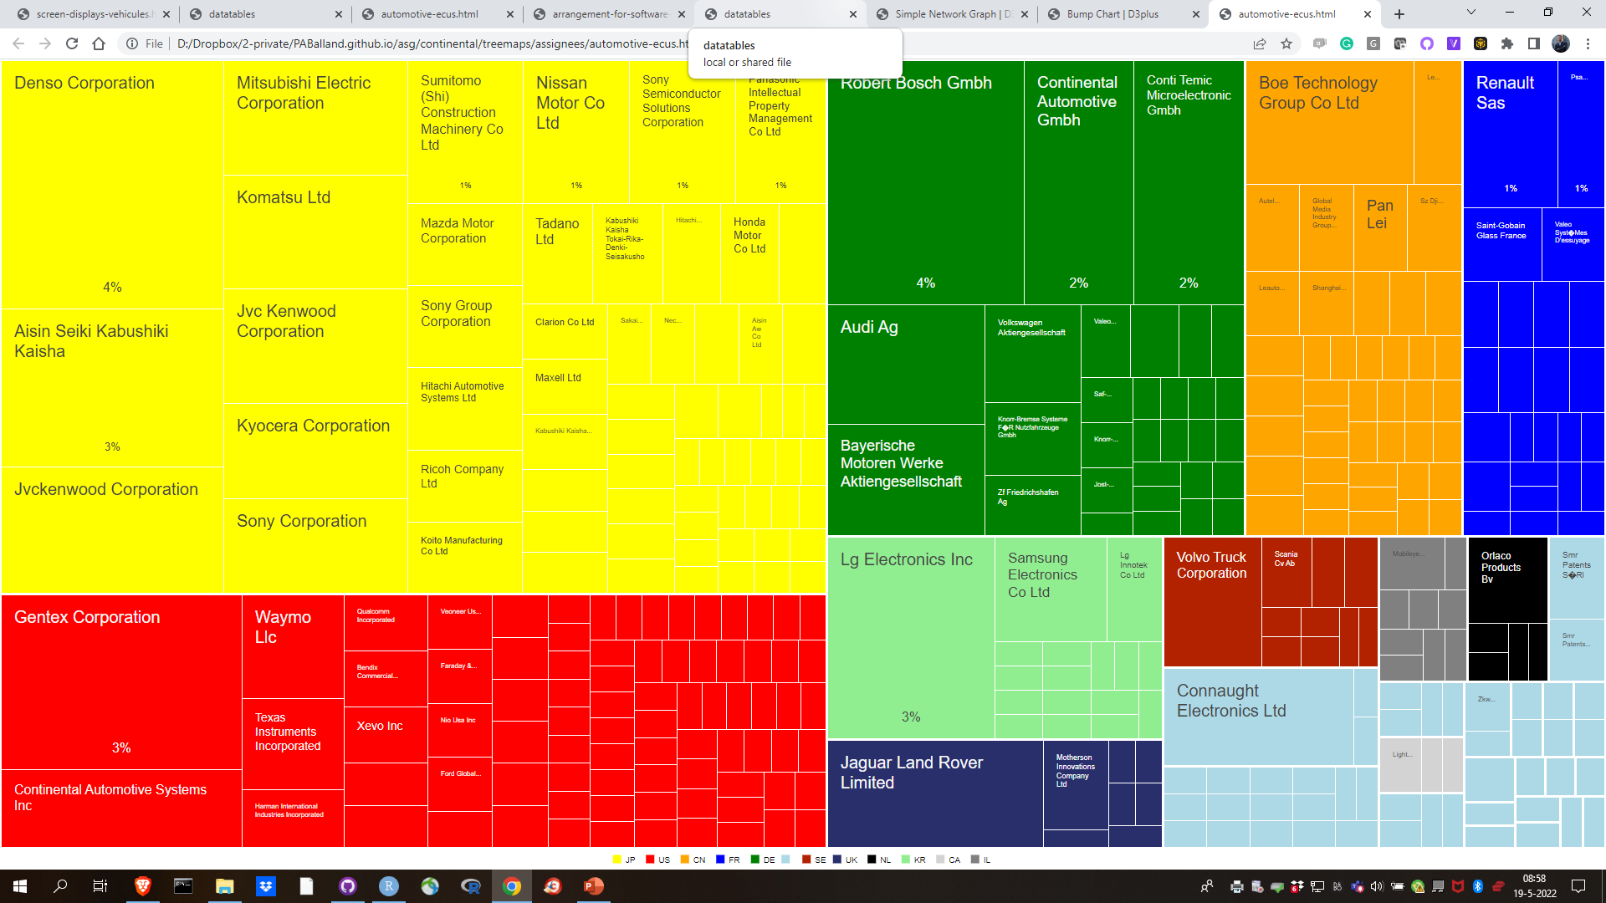
Assignees

Slide 12
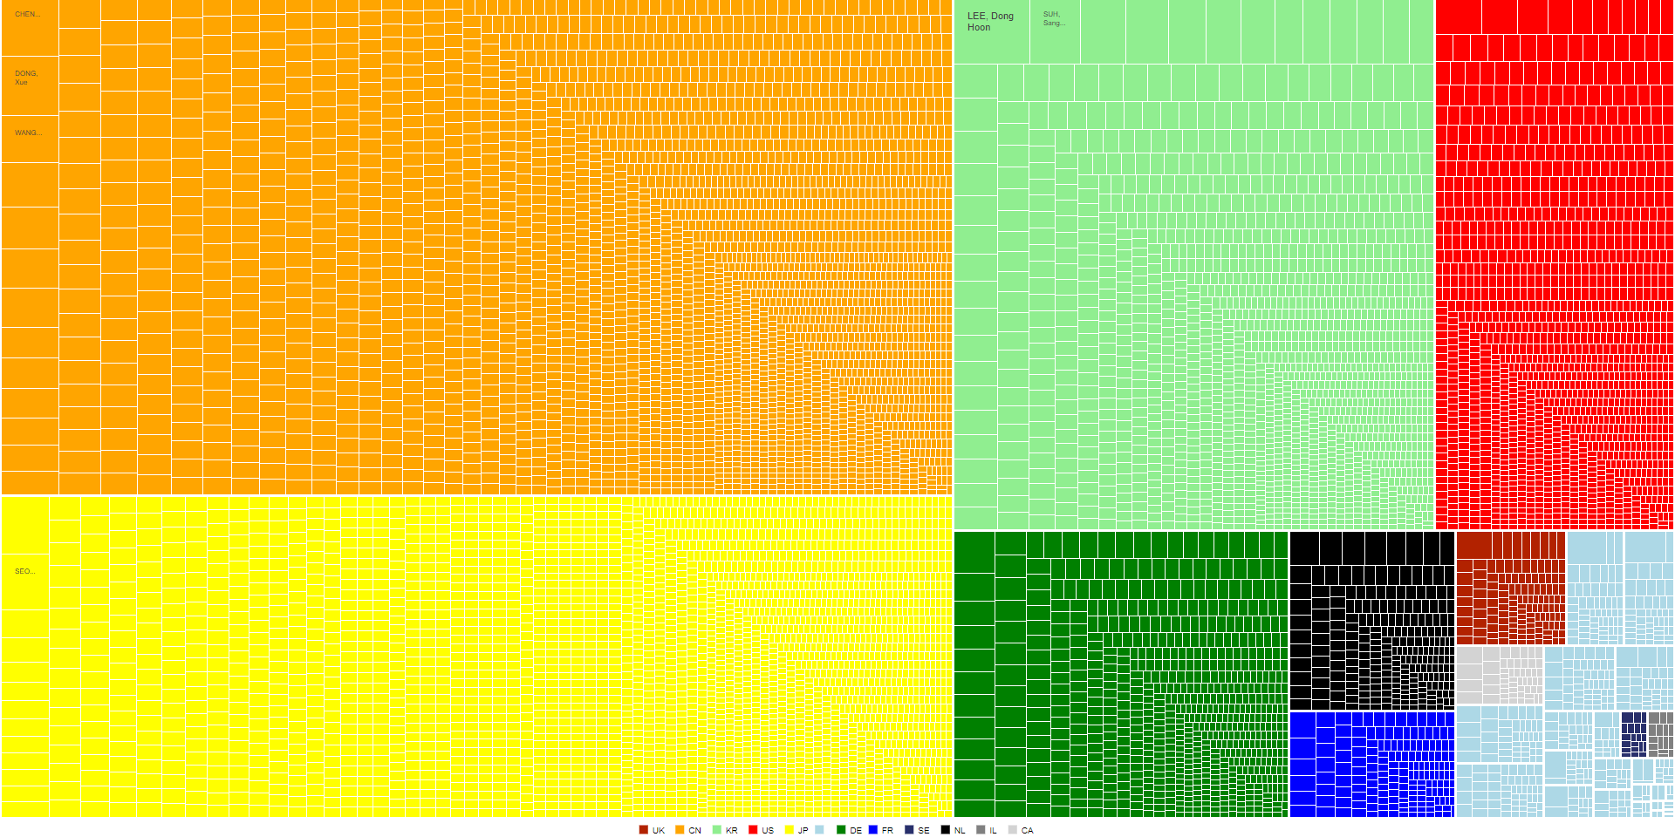
Inventors

Slide 13
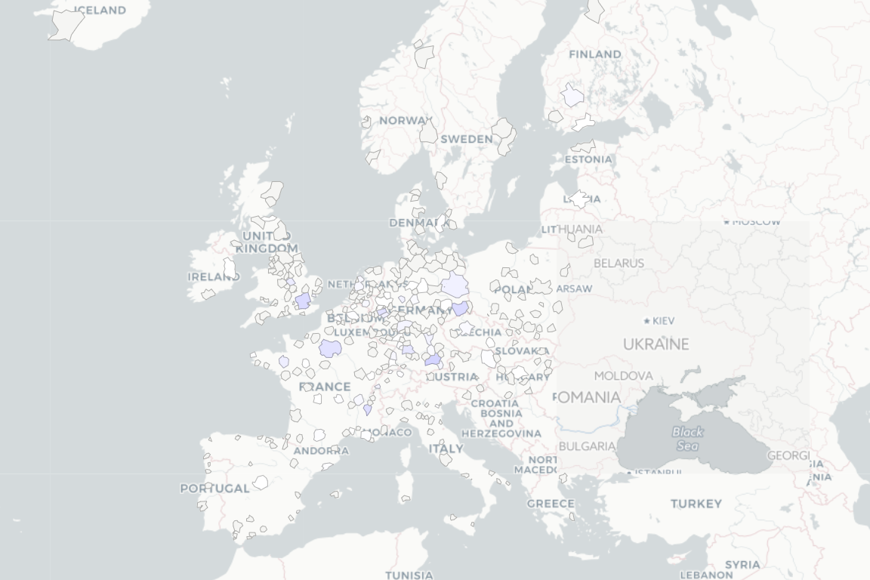
Mapping eco-systems

Slide 14
Pierre-Alexandre Balland Directeur Général contact@argosgroup.net +33 609 48 68 50

